Slide 1
Gypsy, Roma and Travellers
Representing the under-represented in HE
Dr Emily Danvers, Lecturer in Education University of Sussex, Maxine Lambert, Teacher, Friends, Families and Travellers and Tommy Buck, Policy and Outreach Worker, Friends, Families and Travellers
e.danvers@sussex.ac.uk
Notes:
Academic presentation/content – 15 minutes
Practitioner presentation/content – 15 minutes
Student voice – 10 minutes
QnA – 15-20 minutes

Slide 2
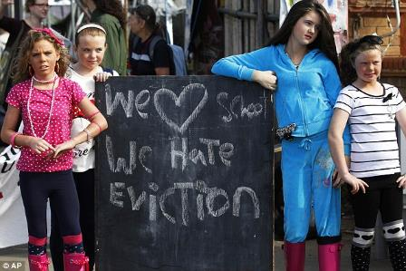
Our plan
Emily will explain why GRT students are a marginalised minority within UK higher education and reflect on Sussex initiatives to support their educational trajectories.
Maxine will help us understand how the work she does helps break down barriers the GRT community face in education, as well as the need for more inclusive approaches.
Tommy will share some of his own experiences, state some of the barriers GRT students face and tell us the value of a mentor scheme.
Notes:
Allow you to think about inclusion and how to ‘differentiate’ to meet the needs of GRT pupils – how to break down barriers.

Slide 3
GRT in higher education
GRT a diverse community who experience historic marginalisation across multiple social policy areas.
Lack of accurate data to capture the educational pathways of GRT
UCAS data from 2018 indicated 110 applicants and 70 acceptances (that have increased from 70/50 in 2013).
HESA returns in 2016 suggested that only 3 to 4% of GRT young people aged 18–30 accessed HE in 2014/15, whereas 43% of the national 18–30 year old population did so. (Mulcahy et al., 2017)
Notes:
The lack of accurate data which can capture the reality of life in the UK for GRT communities is a recurring theme across social policy areas, including education. he 2011 census included for the first time an ethnic category entitled ‘Gypsy, Traveller and Irish Traveller communities’. The census counted around 63,000 people in the UK identifying as members of these groups.
Access to HE for GRT communities is not increasing Evidence on progression to HE for those from GRT communities indicates that only very small numbers of learners from such communities progress to HE. Data from the Department of Education shows that from 2009–10 to 2017–182 for all other white groups the trend in HE participation is upwards. However, for Travellers of Irish heritage it has declined and Gypsy/Roma groups it has remained static.
‘Vulnerable groups of children are often missed from large-scale statistical analysis of children at risk of poverty and deprivation because they are not included in the sampling frame for survey data, because they are present in too small numbers, or because the characteristics that would identify them as at risk are not recorded. Roma, Gypsy and Traveller children across Europe are missed for all three reasons.

Slide 4
Persistent barriers to higher education
My parents wanted me to learn to read and write because they can’t do it. They couldn’t help me with my homework. As they said you need your education cos the world is changing and you won’t get anywhere if you can’t read or write’
(Mapping for Change, 2019
‘Poor’ progression through compulsory schooling
Experiences of racism and bullying, a lack of understanding of GRT culture and historic and cultural valuing of particular forms of work (Bhopal and Myers, 2016)
These factors impede access opportunities to higher education
Notes:
Researchers conduct forty-four qualitative interviews with young Travellers in London aged 15–25. The research found that 61% of the young Travellers left school before 16 with 2 reaching higher education. Nearly 70% of the participants felt they had been bullied by their teacher.
Not simply a cultural ‘choice’ to absent..
A key factor to this educational trajectory is a lack of progression through compulsory schooling with GRT pupils having higher overall and persistent absence rates than any other ethnic group in England and the lowest average attainment score at key stage four (Department of Education 2018a and 2018b). Some of the main contributing issues cited for this education ‘achievement gap’ include experiences of racism and bullying, a lack of understanding of GRT culture by teachers, as well as cultural and historical valuing of particular forms of work (Bhopal and Myers, 2016). The prevalence of racism and bullying experienced by GRT pupils in schools is unsurprising given that a 2018 Equality and Human Rights Commission report describes how GRT were the only protected characteristic group in the UK for which the most frequent response was openly negative.

Slide 5
A marginalised minority within WP
Less than 30% of Access and Participation Plans (APPs) mention GRT learners and less than 5% include specific activities to support access to higher education. (Atherton, 2020)
Rom Belong Scheme (KCL) is notable in providing a scholarship, mentoring and network of events for GRT students. Parallels other EU approaches for Roma (e.g. Roma Access Programme, CEU)
There is a lack of national direction and impetus for widening access to, and supporting the retention and success of, Gypsies, Travellers and Roma in UK higher education (Danvers, 2015).
Notes:
None contain any numerical targets relating to the access, participation or success in higher education of those from GRT communities.
ild positive role models in the form of student networks of current and graduated Gypsy, Roma and Travellers, prioritising and giving special consideration to GRT students and putting on targeted events to inform young people and their families about their choices and their rights when it came to education.

Slide 6
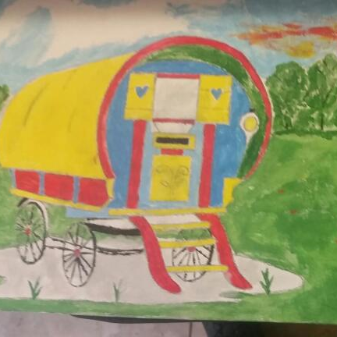
Our work in Sussex
Sussex GRT Collaborative – a network including representation from academics, widening participation, local authority, schools and community.
Supporting GRT Educational Transitions – a project designing and evaluating a GRT focused WP initiative in East Sussex. (Danvers, Hinton-Smith, Derbyshire and Lewis, 2019)
Learning under Lockdown – creative art project reflecting on the impacts of covid-19 on GRT young people and their ‘future selves’.
Notes:
The Sussex GRT Collaborative includes representation from FFT (an advocacy charity for this community), from both academic and widening participation aspects of University of Sussex, from the Local Authority, from representation from the community, and from schools supporting the same at both Primary, and Secondary level.
The Sussex GRT Collaborative emerged against the concerns generated by various documented statistics evidencing the difficult passage young learners from a GRT background experience in their educational growth. This collaborative has:
developed an informal but regular forum exploring our understanding of these learners
provided support, opportunity, and intervention exploring their futures
created a space for educational issues related to this group of learners to be considered in a proactive, positive light
prompted additional initiatives that has focused on student voice, family inclusion, positive inclusion

Slide 7
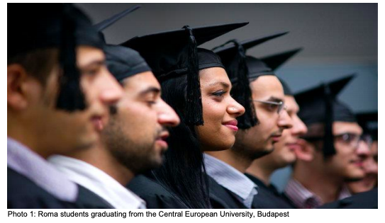
Recommendations
Need for holistic, bespoke and targeted support (from finances to parental engagement) from schools to HE.
Developing belief in HE as part of future selves BUT also need for inclusive school practices and curricula in order to attain.
Recognition of complex lives and identities of GRT and the need to change dominant prejudiced perspectives.
Notes:
Need for bespoke targeted support
Relevance of BAME stuff but not GRT specific and BAME doesn’t really speak to them.
Hidden minority.
Engaging whole family/community.
Can’t look at university if can’t get that far. Only officer responsible up to age 16, not after.
Need to listen to and engage GRT on own terms (voice from previous paper)
Listening to what GRT need and want, not assuming.
Good practice – education on a bus.
Universities need to be present where GRT are – e.g. horse fairs. Won’t get much first time but then become part of it. Need to win trust. (Link with our event which GRT didn’t come to + our inclusive approach to trip with families invited too).
Need to change dominant racist perceptions – that’s the deficit not GRT
Pippa: Institutional racism against bringing GRT people on to campus.
Afterwards it changed view of college.
Jenny – institutional racism too – people not wanting GRT kids to get extra opportunities – teachers’ perceptions of kids because they know kids and parents.
Need for cultural awareness training for organisations (e.g. Pippa’s college colleagues changing their minds).

Slide 8
References
Atherton, G. (2020). More than luck: enabling access and success in Higher Education for Gypsy, Romany and Traveller (GRT) communities. London: Sir John Cass Foundation.
Bhopal, K. and Myers, M. (2016) ‘Marginal groups in marginal times: Gypsy and Traveller parents and home education in England, UK’. British Educational Research Journal. 42, 1: 5-20.
Danvers, E. (2015). Supporting Roma Students in Higher Education. Briefing Report on Higher Education, Internationalisation and Roma in the UK. http://www.sussex.ac.uk/education/cheer/researchprojects/rise/outputs
Danvers, Hinton-Smith, Derbyshire and Lewis (2019) Supporting Gypsy, Roma and Traveller Educational Transitions. Brighton: Sussex Learning Network.
Mapping for Change (2019) Discrimination in London schools against Gypsies and Travellers www.mappingforchange.org. uk/2019/07/discrimination-inlondon-schools-againstgypsies-and-travellers
Mulcahy et. al. (2017) The underrepresentation of Gypsy, Roma and Traveller pupils in higher education: A report on barriers from early years to secondary and beyond. London: KCL.

Slide 9
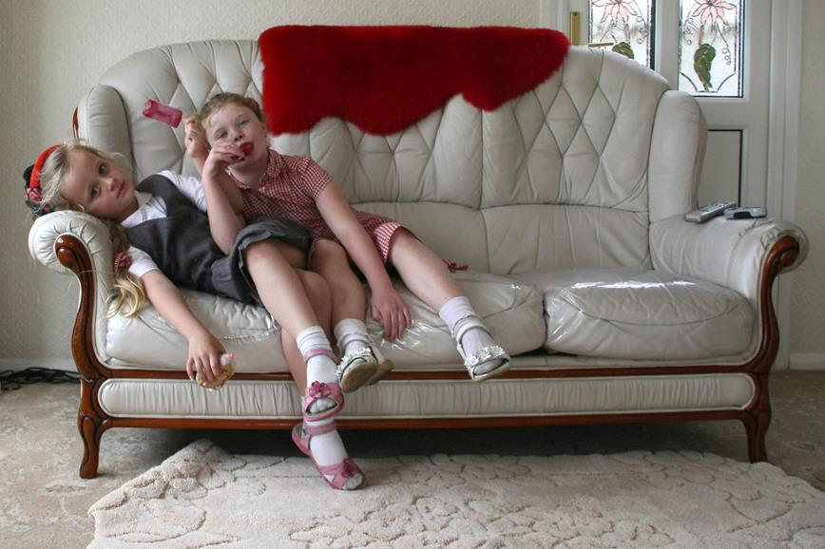
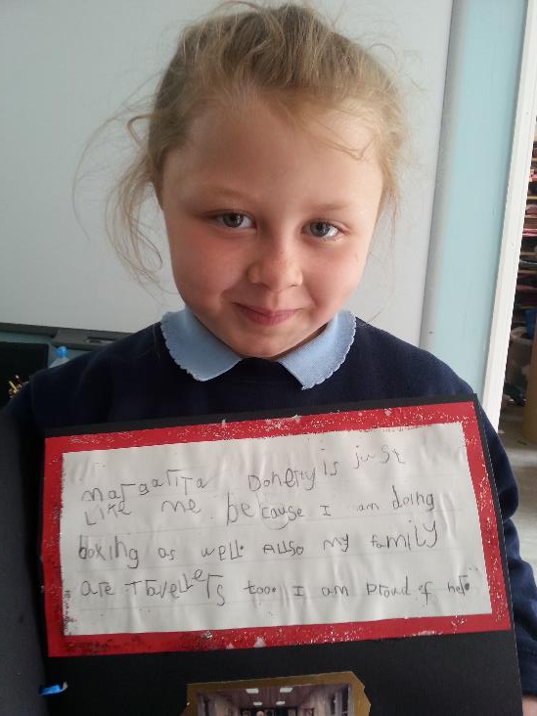
Maxine Lambert: Breaking down the barriers
"Irish Traveller Mary Ann McCarthy's grandchildren, Mary Ann and Mary Ann, who are facing eviction from Dale Farm Travellers' site in Essex" by The Advocacy Project is licensed under CC BY-NC-SA 2.0

Slide 10
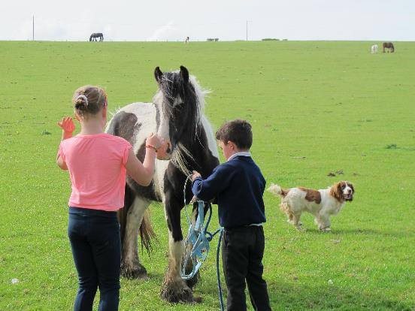
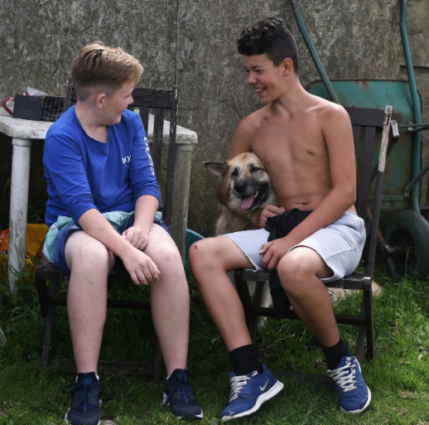
What I aim to cover today…
GRT experience
Case study
Inclusion & good practice 'big picture’
Classroom practice – what I do

Slide 11
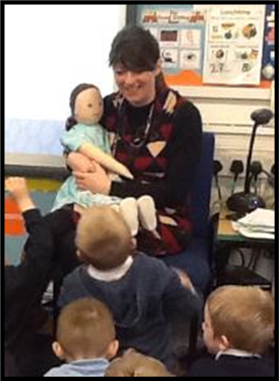
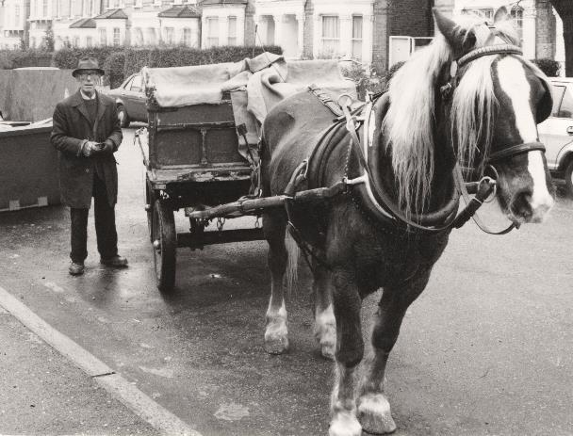
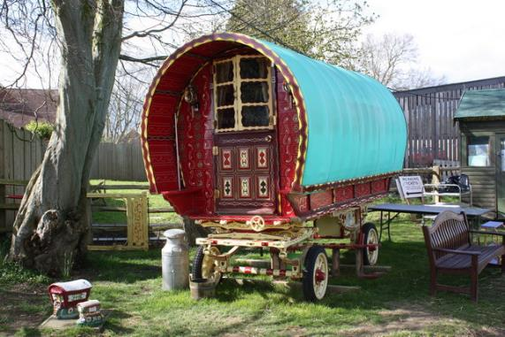
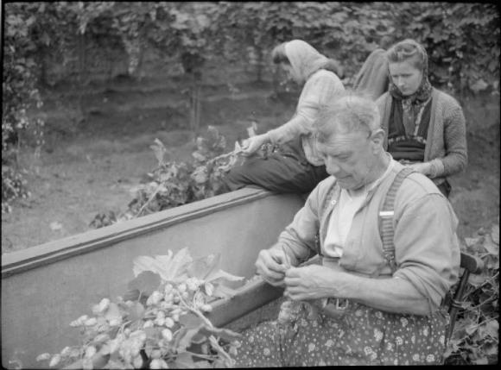
Who am I?

Slide 12
What do you know about Gypsies and Travellers?
What do you hear in the press?
Share ideas on the chat please and report back…
30 seconds…

Slide 13
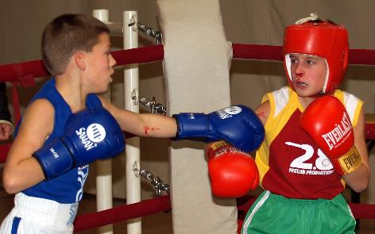
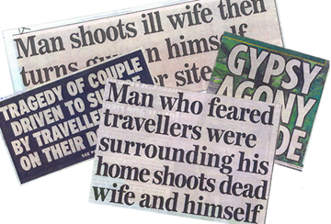
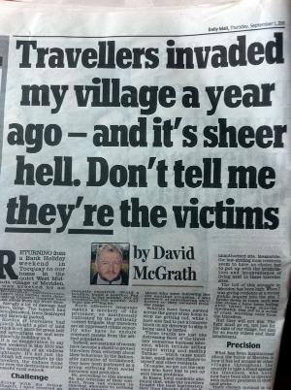

Slide 14
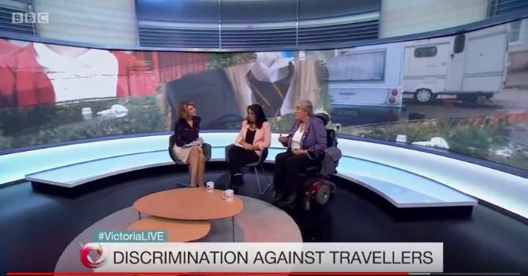
https://www.youtube.com/watch?v=oSa0pBwcJwM Beginning to 1.58
Think: what do you find out about teachers views of Travellers?
Use the chat box to reflect on this – 30 seconds.

Slide 15
Being anti-Traveller is Racism
Anti-Bullying Alliance report ‘Bullied, Not Believed and Blamed’ 2020

Slide 16
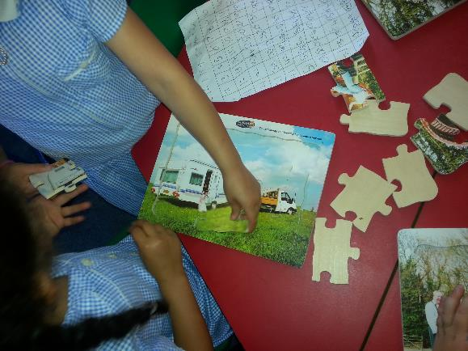
Case study
Using the scenario given note using the chat
box (please use the number):
1. What might be the challenges for the child?
2. What might be the challenges for the family?
3. What might be the challenges for the teacher?
4. What might be the challenges for the school?

Slide 17
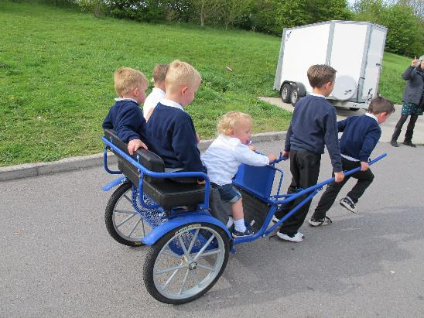
Scenario One: Shakira
Shakira is a Traveller of Irish Heritage, aged 5. She has spent all of her life ‘roadside’, with regular evictions (being moved on by the police). At the moment the family are staying on the Travellers transit site, so will be stable for three months. There is no WIFI on the site, and network coverage is patchy. Her elder two brothers (Years 5 and 6) have had a very disrupted schooling, and she has never been to school or nursery. She has just started school (in Year 1) in October. Neither of her parents can functionally read or write, and they need help with filling forms. The school uses ‘parent pay’ an online system for consent and payment (say for trips). The family did not ascribe as ‘Travellers of Irish heritage’ on their school forms, but they are known to the Traveller Education Support Unit (who have supported the brothers when in school). The school wonders if they will stay with them, or will move to a new school/move on. The class teacher is an NQT.

Slide 18
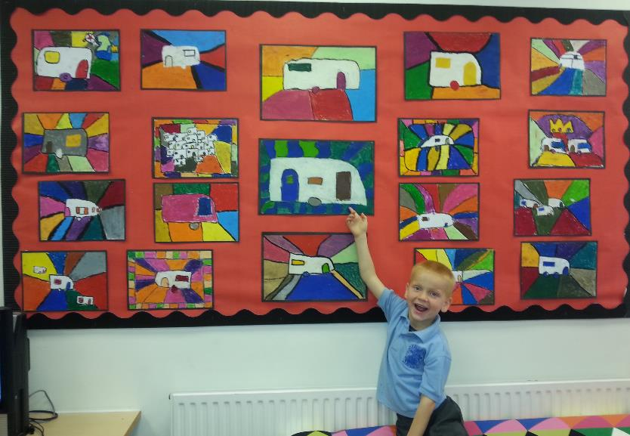
Case Study
Shakira is a Traveller of Irish Heritage, aged 5. She has spent all of her life ‘roadside’, with regular evictions (being moved on by the police). At the moment the family are staying on the Travellers transit site, so will be stable for three months. There is no WIFI on the site, and network coverage is patchy. Her elder two brothers (Years 5 and 6) have had a very disrupted schooling, and she has never been to school or nursery. She has just started school in Year 1 in October. Neither of her parents can functionally read or write, and they need help with filling forms. The school uses ‘parent pay’ an online system for consent and payment (say for trips). The family did not ascribe as ‘Travellers of Irish heritage’ on their school forms, but they are known to the Traveller Education Support Unit. The school wonders if they will stay with them, or will move to a new school/move on. The class teacher is an NQT.
Using the scenario given, make notes under the headings:
1. What might be the challenges for the child?
2. What might be the challenges for the family?
3. What might be the challenges for the teacher?
4. What might be the challenges for the school?

Slide 19
Challenges
Child
School
Being away from family
Needs time to ‘settle’
Structures/routines
Is behind - self-esteem
‘Gorgias’ (settled non-Travellers) worrying
School food is ‘different’
Why resource a child that may leave? Intervention might not be provided (it won’t show on the data)
Affects attendance figures
Doesn’t understand ‘Traveller’ ways – might be judgemental (or ridicules) or stereotypes
School structures (e.g. office systems) rely on literacy (and ICT): too much effort to change or adapt/be inclusive
Family
Teacher
Are worried about leaving their child
Worried about discrimination
Keep getting letters home they can’t read
No-one calls to tell them what they need to do
They need time off (for a family death) but school doesn’t understand – keep being ‘shirty’ about time off – fines looming
Hasn’t time to settle/instruct in routines (I’ve done that!)
Finds it hard to differentiate (other pupils ahead)
Doesn’t want to admit to lack of knowledge
Unsure how to approach parents
Is fearful (or doesn’t understand ‘Traveller’ ways e.g. importance of extended family – funerals etc.)

Slide 20
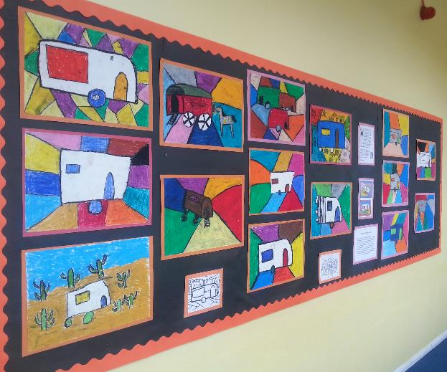
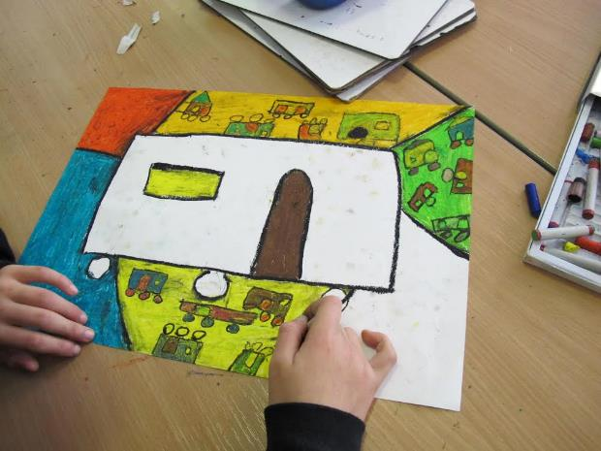
Action plan:
The teacher could/should Be inclusive Seek help Trusting relationships Culturally appropriate materials Assume that the child is staying Offer additional support Extra mile (did my pupil eat lunch today?) Be kind and understanding Differentiate effectively | The school could/should Be inclusive Celebrate diversity -Curriculum Seek help Offer booster groups Avoid digital exclusion 2010 Equalities act Support their teachers to differentiate effectively

Slide 21
The web of barriers leading to disengagement from educational institutions…includes:
Institutional racism
Structural racism e.g. not understanding debt aversion by some cultures
Lack of celebration of culture
Bullying by other children
Racism from teachers – low expectations
Assumption that not academic
Barriers
Lack of representation e.g. staff, teachers
Digital exclusion
Fines for absence/lateness
Inaccessible sites on the edge of towns/lack of transport to schools
Lack of support for poor literacy

Slide 22
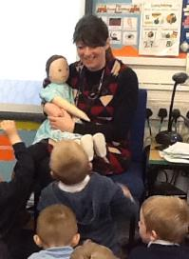
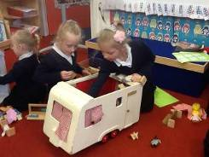
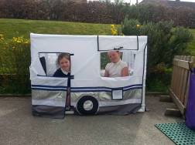
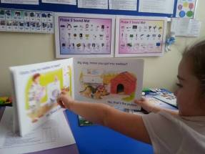
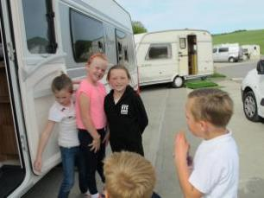
What we do in Brighton & Hove
Provide personalised TEACHER led intervention – phonics, reading comprehension EEF – evidence based impact
Culturally relevant
Meet and engage families
Assist and advocate – or signpost (e.g. AMAZE)
Provided FREE to schools – but comes with a challenge too
Intervene before exclusion – behaviour support
Support transition into school and from school to school
Train schools, governing bodies, teachers
Assemblies, lessons, persona dolls - GRTHM
‘No child should be expected to cast off the language and culture of the home as he crosses the school threshold… the curriculum should reflect those aspects of his life.’ Bullock Report, ‘A Language for Life’.

Slide 23
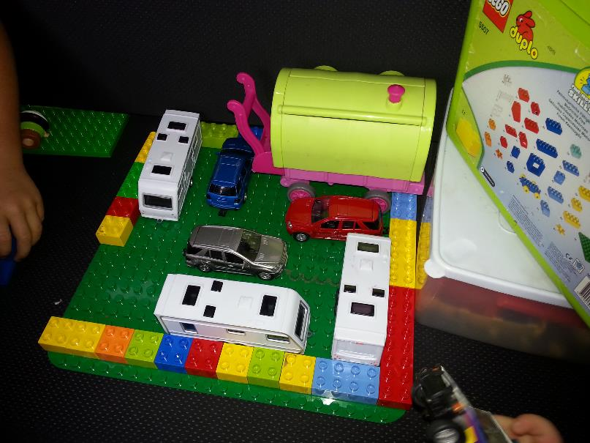
General question time
In your groups come up with any questions that you may have.

Slide 24
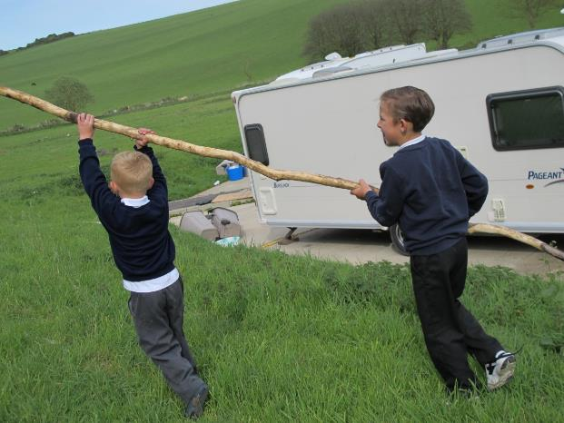
Thank you for listening

Slide 25
What will I discuss?
Who am I and what my role is at Friends, Families and Travellers?
What are some of the main barriers which prevent members of the community attending higher education institutions?
What do I mean by “The pledge”?
What barriers have I experienced whilst applying to higher education and my journey through university.

Slide 26
Who am I and what does my role entail?
Projects and Policy Officer at Friends, Families and Travellers.
Working with young members of the community in numerous ways such as setting up clubs to improve their confidence and planning educational trips.
Helping members of the community access mainstream services including benefits, health services and accommodation.
Developing education policy.

Slide 27
What are some barriers?
Community members have a lack of role models and therefore are not able to vision themselves in higher education.
Family members might not see the importance of education and students from the community might not have the support from their family to pursue this academic journey.
Members of the community might not have access to teachers who can support them with personal statements and references etc.
Some members of the community do not have the digital skills or access to technology to apply to university and participate in courses.
Bullying from other children in the early stages of education can put them of higher education.

Slide 28
What do I mean by “The pledge”?
University, College or Institution to undertake certain steps to support GTRSB (Gypsy, Traveller, Roma, Showpeople, Boaters) students into and within higher education.
Universities sign up to this pledge by their Vice Chancellor writing a letter supporting the pledge and stating they want to sign up to it.
data monitoring of GTRSB student and staff numbers.
building a supportive and welcoming culture for GTRSB students.
outreach and engagement to local communities and inclusion
celebration of cultures and communities.
The pledge has been developed after consultation with members of the community.
helping Gypsy, Roma, Traveller, Showmen and Boater students to access and remain in higher education.

Slide 29
What barriers have I personally experienced?
I did not have access to computers/technology at home when studying a-levels which made it very difficult to apply for university and to secure the grades needed to secure a place at university.
My father having low literacy made it challenging to apply for student finance.
Lack of support from universities – they did not reach out.

